Slide 1

P-7 Self-Driving Car Game Capstone Project - AIDI 2005
Submitted by:
Jaivardhan Singh - 100849063
Usman Qureshi - 100847689
Hamad Aslam - 100851221
Khaleel Khan Patel - 100851770
Moaz - 100849590
Irfan Shaik - 100855785
Under the guidance of:
Marcos Bittencourt

Slide 2
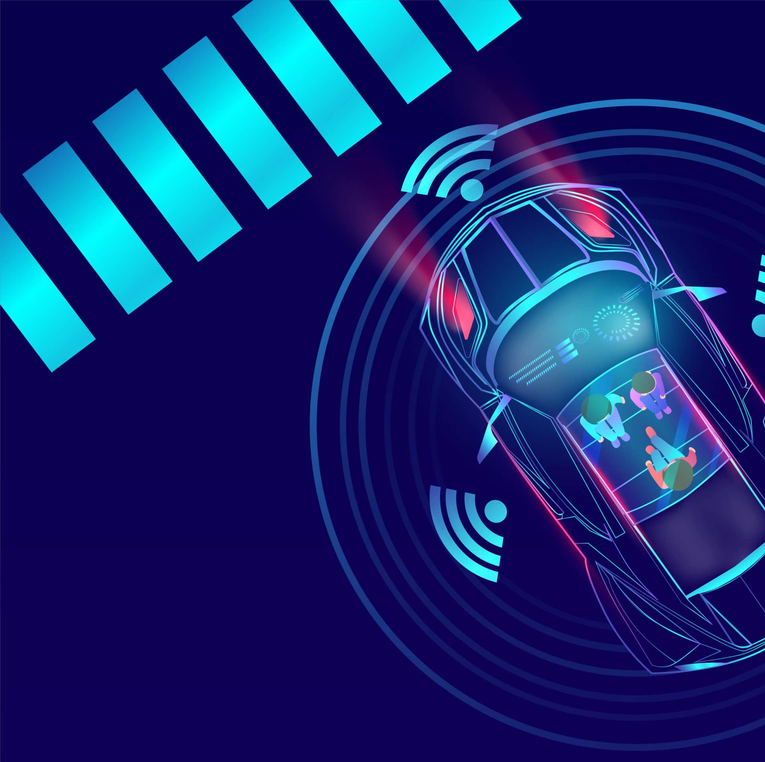
Self-Driving Car
A self-driving car, also known as an autonomous vehicle (AV), autonomous car, driverless car, or robotic automobile (robo-car), is a ground vehicle capable of recognizing its environment and travelling safely with little or no human input.

Slide 3
Why Deep Learning
It's Effective With Unstructured Data
Self-Learning Capabilities
Efficiency in terms of cost
Scalability

Slide 4
Technology stack
For Reinforcement Learning Model
C#
Python
Reinforcement learning
Unity Engine

Slide 5

Working of Model

Slide 6
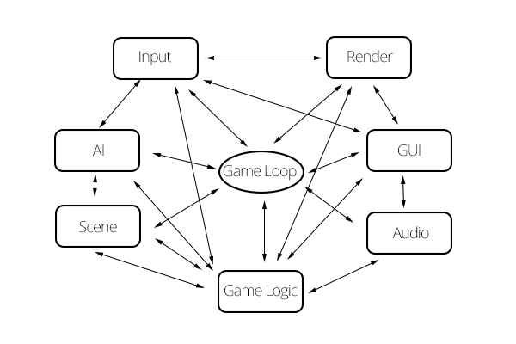
Project Application
Source: https://www.gamedeveloper.com/programming/writing-a-game-engine-from-scratch---part-1-messaging

Slide 7
Project Deliverable
AI assisted Self driving model
AI VS Human Game
Multiple Racetracks and different car models

Slide 8
Thank you!

